Slide 1
Transposition Ciphers
now consider classical transposition or permutation ciphers
these hide the message by rearranging the letter order
without altering the actual letters used
can recognise these since have the same frequency distribution as the original text
Notes:
All the techniques examined so far involve the substitution of a ciphertext symbol for a plaintext symbol. A very different kind of mapping is achieved by performing some sort of permutation on the plaintext letters. This technique is referred to as a transposition cipher, and form the second basic building block of ciphers. The core idea is to rearrange the order of basic units (letters/bytes/bits) without altering their actual values.

Slide 2
Rail Fence cipher
write message letters out diagonally over a number of rows
then read off cipher row by row
eg. write message out as:
m e m a t r h t g p r y
e t e f e t e o a a t
giving ciphertext
MEMATRHTGPRYETEFETEOAAT
Notes:
The simplest such cipher is the rail fence technique, in which the plaintext is written down as a sequence of diagonals and then read off as a sequence of rows.
The example message is: "meet me after the toga party" with a rail fence of depth 2.
This sort of thing would be trivial to cryptanalyze.

Slide 3
Row Transposition Ciphers
a more complex transposition
write letters of message out in rows over a specified number of columns
then reorder the columns according to some key before reading off the rows
Key: 3 4 2 1 5 6 7
Plaintext: a t t a c k p
o s t p o n e
d u n t i l t
w o a m x y z
Ciphertext: TTNAAPTMTSUOAODWCOIXKNLYPETZ
Notes:
A more complex transposition cipher is to write the message in a rectangle, row by row, and read the message off shuffling the order of the columns in each row.
A pure transposition cipher is easily recognized because it has the same letter frequencies as the original plaintext. For the type of columnar transposition just shown, cryptanalysis is fairly straightforward and involves laying out the ciphertext in a matrix and playing around with column positions. Digram and trigram frequency tables can be useful.

Slide 4
Cryptography technique
Symmetric key cryptography
Asymmetric key cryptography

Slide 5
Symmetric key encryption
Symmetric encryption uses a single key to encrypt and decrypt. If you encrypt a zip file, then decrypt with the same key, you are using symmetric encryption. Symmetric encryption is also called “secret key” or private key encryption because the key must be kept secret from third parties.

Slide 6
Requirements
two requirements for secure use of symmetric encryption:
a strong encryption algorithm
a secret key known only to sender / receiver
mathematically have:
Y = E_{K}(X)
X = D_{K}(Y)
assume encryption algorithm is known
implies a secure channel to distribute key
Notes:
We assume that it is impractical to decrypt a message on the basis of the cipher- text plus knowledge of the encryption/decryption algorithm, and do not need to keep the algorithm secret; rather we only need to keep the key secret. This feature of symmetric encryption is what makes it feasible for widespread use. It allows easy distribution of s/w and h/w implementations.
Can take a closer look at the essential elements of a symmetric encryption scheme: mathematically it can be considered a pair of functions with: plaintext X, ciphertext Y, key K, encryption algorithm E_{K}, decryption algorithm D_{K}.

Slide 7
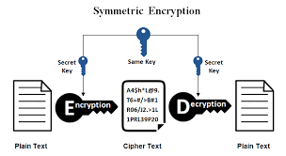
Notes:
Detail the five ingredients of the symmetric cipher model, shown in Stallings Figure 2.1:
plaintext - original message
encryption algorithm – performs substitutions/transformations on plaintext
secret key – control exact substitutions/transformations used in encryption algorithm
ciphertext - scrambled message
decryption algorithm – inverse of encryption algorithm

Slide 8
Requirements
two requirements for secure use of symmetric encryption:
a strong encryption algorithm
a secret key known only to sender / receiver
mathematically have:
Y = E_{K}(X)
X = D_{K}(Y)
assume encryption algorithm is known
implies a secure channel to distribute key
Notes:
We assume that it is impractical to decrypt a message on the basis of the cipher- text plus knowledge of the encryption/decryption algorithm, and do not need to keep the algorithm secret; rather we only need to keep the key secret. This feature of symmetric encryption is what makes it feasible for widespread use. It allows easy distribution of s/w and h/w implementations.
Can take a closer look at the essential elements of a symmetric encryption scheme: mathematically it can be considered a pair of functions with: plaintext X, ciphertext Y, key K, encryption algorithm E_{K}, decryption algorithm D_{K}.

Slide 9
Drawback of symmetric cryptography
Key distribution or key exchange
No. of keys required =n(n-1)/2
Solution for the problem of key exchange is diffie hellman key exchange algorithm.

Slide 10
Asymmetric key cryptography
Asymmetric cryptography, also known as public-key cryptography, is a process that uses a pair of related keys -- one public key and one private key -- to encrypt and decrypt a message and protect it from unauthorized access or use.
A public key is a cryptographic key that can be used by any person to encrypt a message so that it can only be decrypted by the intended recipient with their private key. A private key -- also known as a secret key -- is shared only with key's initiator.

Slide 11
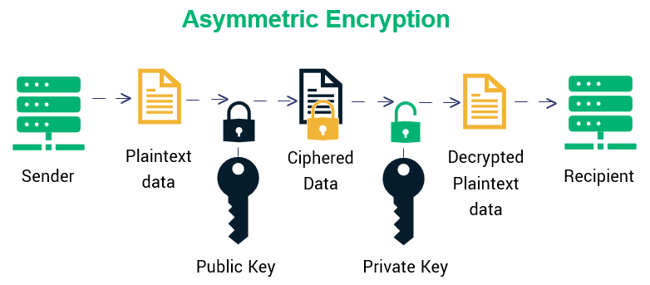

Slide 12
Difference between symmetric and asymmetric key cryptography
Same key is used for encryption and decryption. Speed of encryption/decryption is very fast. Key agreement is very big problem. No. of key required is n(n-1)/2. Not used for digital signature. | One key is used for encryption nd different key is used for decryption. Speed of encryption/decryption is slow. No problem at all. No. of key is equal to the no. of participants. Used for digital signature.

